Slide 1
West Fraser Timber Co Ltd.
Karanpreet Kaur , Derek Everard, Richael Campbell
Notes:
karan

Slide 2
Company Overview
West Fraser Timber Co Ltd., also known by the name West Fraser is a Canadian based forestry corporation , with their headquarters in Vancouver , BC. West Fraser produces a vast variety of products such as lumber , pulp , plywood etc.
West Fraser has well established operations in both Canada and US.
Notes:
karan

Slide 3
Organizational Structure
West Fraser has a complex organizational structure. Breakdown of their organizational structure is as follows :
Board of directors : They hold control over major decisions within the company.
Executive team : Executive team is lead by Chief Executive officer and it consist of CFO , COO and CMO , who are leaders of their respective teams.
Business Units : West Fraser specializes in multiple products like lumber, pulp and they have a different units that is responsible for the production and sales of that product.
Notes:
karan

Slide 4
Financial Overview
If we look at the West Fraser’s revenue, company reported a massive decline of 33.5% in the revenue for the fiscal year 2023, as compared to 2022. In 2024, during the 1st quarter company reported a hike of 7.5% in the revenue, as compared to the numbers during the last quarter.
Notes:
karan

Slide 5
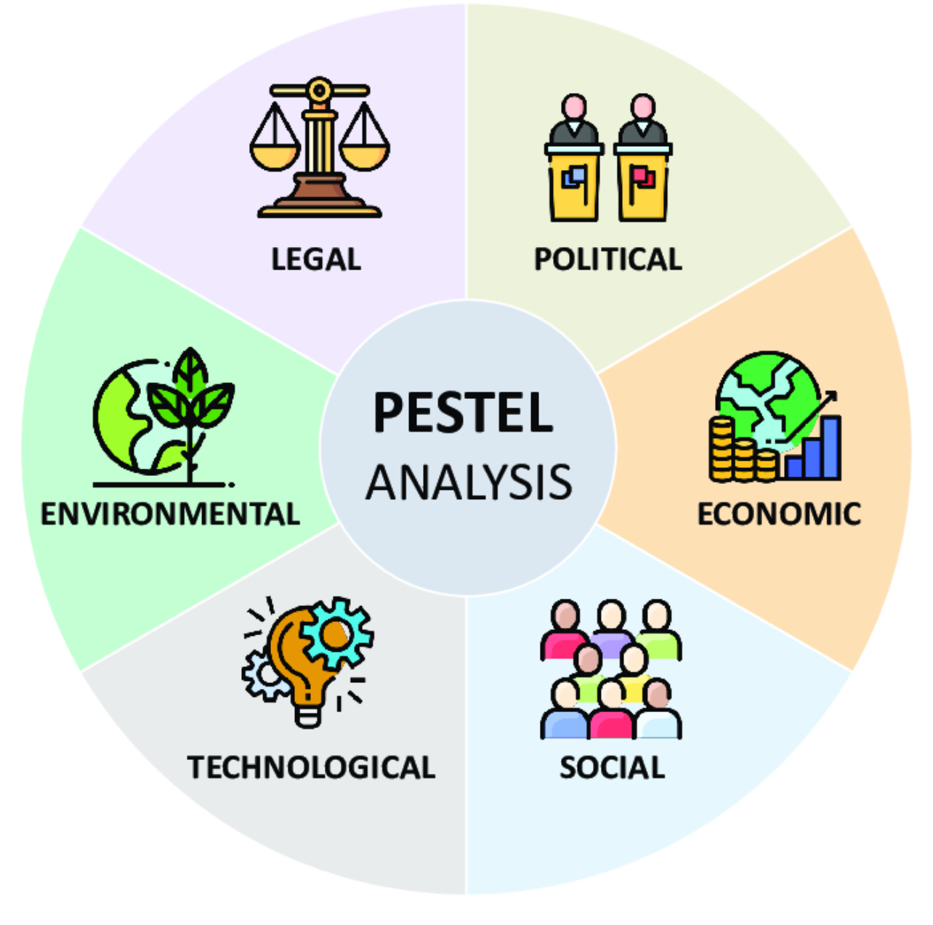
Company Situation
Notes:
karan

Slide 6
Political Factors
Political Stability and Trade Policies: The stable canadian government supports policy consistency and investor confidence for West Fraser Timber, despite minor political uncertainties. Trade policies impact West Fraser’s largest market, the U.S., where tariffs on Canadian softwood lumber continue to be a contentious issue under the USMCA, with 2023 rates at 20%.
Sustainability and Forest Management: Canada’s strict forest management regulations require sustainable practices, which West Faser can do by following stewardship plans under acts like British Columbia’s Crown Forest Act.
Notes:
derek

Slide 7
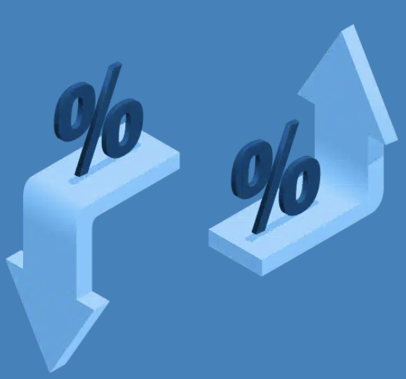
Economic Factors
Market Value of the Commodity : The trends in the housing market and changing economic conditions all around the globe cause fluctuations in the supply and demand, which in turn causes variations in the lumber prices. These variations directly influence the company’s profits and revenue.
Interest Rates : The continuous variations in the interest rates can influence the ability to afford a house and construction operations, which put an impact on the market demand for the lumber products. Therefore, higher interest rates decrease the demand. Whereas lower interest rates increase the demand.
Notes:
karan

Slide 8
Social
Community Engagement : West fraser proactively takes part in the community engagement by investing millions of dollars in community programs, that supports a wide range of projects such as initiatives promoting conservation of the environment.
Demographic profile of the workplace : West fraser is extremely focused on their workplace culture. They believe that diversity within the workplace plays an important part in productivity as well as overall operations of the company.
Notes:
karan

Slide 9
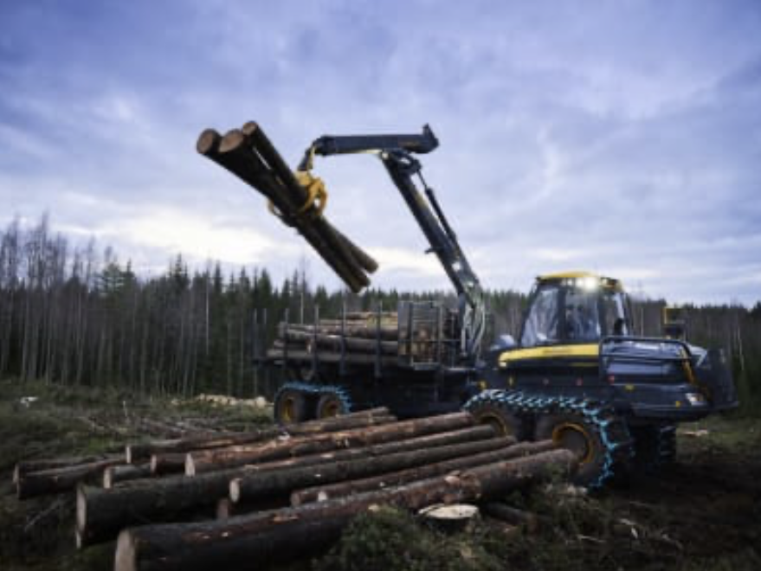
Technology
West Fraser Timber employs advanced machinery and technology to enhance its capabilities. They have invested heavily into computerized saw technology and automation which increases production and reduces waste.
High frequency drying systems has decreased drying times improving the final product and decreasing energy consumption
Notes:
derek

Slide 10
Environmental Factors
Change in climate can put a strain on the forest health. During summer the wildfire can destroy acres of forests causing a halt in the supply of lumber, which in turn can restrict the operations of the company.
Fire also cause regulatory restrictions on the lumber harvesting, as there is only specific amount of lumber that you can harvest.
Swear weather conditions during winter season impact the availability of the transportation to ship the products from mills to the customer.
Notes:
karan

Slide 11
Legal Factors
West Fraser has implemented a sophisticated log tracking system to comply with sustainability standards
West Fraser also complies with labor laws adhering to minimum wage laws depending on the province or state they are operating in.
Notes:
karan

Slide 12
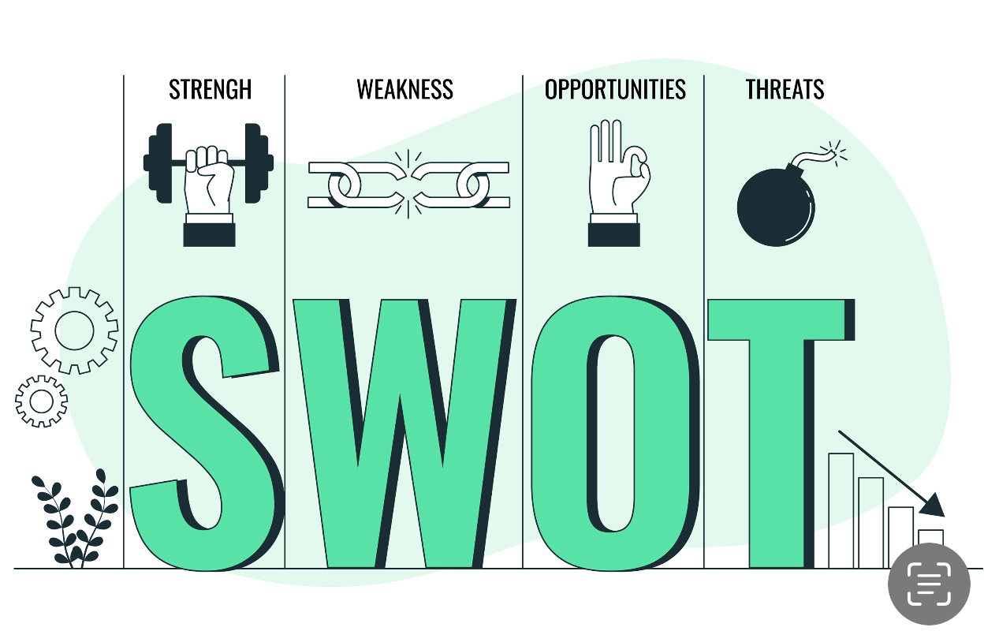
West Fraser Timber Co Ltd : SWOT Analysis
Notes:
richeal

Slide 13
Emphasis on the Quality : Main priority for West Fraser is to ensure the quality standards throughout its operations. They are firm believers that the quality of the products and services plays a huge role in building a loyal customer base.
Focus on Safe Practices : Our main goal is to eliminate any possible risks and to carry out safety practices in order to prevent any sort of injuries and illness.
Notes:
richeal

Slide 14
High operating costs: High operating costs is a big weakness for West Fraser Timber, driven by the industry’s need for skilled laborers and energy-intensive processes. Hiring skilled workers in remote locations increases wages, while rising fuel and energy costs add to production and transportation expenses. These fixed costs reduce West Fraser’s flexibility, so when lumber prices drop or demand slows, profitability can be sharply impacted as the company still must cover these essential expenses.
Dependence On The North American Markets: West Fraser’s revenue relies heavily on North American markets, especially the U.S. housing sector. This dependence limits its growth opportunities in emerging markets and leaves the company exposed to economic downturns in the region.
Notes:
richeal

Slide 15
Remote Work Expansion: The increasing acceptance of remote work allows West Fraser to tap into a broader talent pool, enabling the company to recruit skilled professionals from anywhere. This shift can enhance the organization’s ability to attract top-tier employees.
Digital Transformation: The company can utilize advanced technologies, including AI and machine learning, to improve our production. This could streamline operations and provide better insights into consumer behavior, enhancing overall competitiveness.
Notes:
richeal

Slide 16
Competition: West Fraser Timber faces strong competition from other major North American timber companies. This pressure limits its ability to raise prices, impacting profit margins and market share. Additionally, since timber products are often viewed as commodities with little differentiation, it’s challenging to stand out in the market.
Climate Change Risks: Climate change is a big treat to West Fraser timber, as it impacts forest health, raising the chances of wildfires and pest outbreaks. This can reduce wood supply, increase costs, and put long-term sustainability at risk.
Notes:
richeal

Slide 17
West Fraser’s mission statement acts as the guiding light for the corporation. It conveys company’s dedication to manufacture high quality Lumber products, while still employing sustainable methods.
It also highlights the importance of offering value to the consumers, employees and company investors while prioritizing environmental sustainability and community involvement.
Notes:
karan

Slide 18
West fraser’s vision statement highlights company’s dedication to the long-term growth and leadership in the lumber sector.
Company also intent to set standards for quality of the product and environmental sustainability.They aspires to employ high end technology to improve the quality of the product.
Notes:
karan

Slide 19
West fraser as a company stresses on the importance of providing a safe work environment for all the workers and to make sure of it they have been introducing several safety training programs for the employees.
According to the figures released by company, due to the implementation of the worker safety training programs they were able to reduce workplace incidents by a large percentage.
Notes:
karan

Slide 20
Corporate Objectives
West fraser aim to maintain excellence in the performance by employing continuous improvements in the day to day operations.
Their target is to be the leaders of the lumber industry, through their innovation and sustainability.
West fraser aims to achieve profitability and growth through investments and skilled operations.
Company also emphasise on the employee satisfaction, as they believe workers are the backbone of a company.
Notes:
karan

Slide 21
Corporate Strategies
West fraser is investing in new technology to increase their productivity, which will be helpful to meet their day to day production goals.
They are committed to being environmentally responsible by reducing waste and carbon footprint.
Company is investing in the development of new products, serving the needs of the growing market, which will help them in becoming leaders of the lumber market.
Notes:
karan

Slide 22
Ethics and Sustainability
West Fraser's ethics policies emphasize integrity, teamwork, innovation, competitiveness, and respect as core values guiding its operations. The company ensures compliance with laws, including anti-corruption regulations, through regular audits and transparency in disclosing legal proceedings. These principles are supported by its Code of Conduct and Corporate Governance Policy, fostering a culture of ethical behavior and accountability.
Notes:
derek

Slide 23
Actual sustainability
West Fraser has shown environmental commitment by planting over two billion trees since 1955 and reducing Scope 1 and 2 greenhouse gas emissions by 15.5% since 2019, achieving 34% of its 2030 target. On the social front, the company achieved its lowest serious injury rate in 2023 and is advancing partnerships with Indigenous Nations, aiming for Progressive Aboriginal Relations Gold-level certification by 2030.
Notes:
derek

Slide 24
Sustainability Plan
West Fraser's sustainability plan focuses on environmental stewardship, social responsibility, and strong governance practices. Key initiatives include sustainable forest management, net-zero emissions targets, reforestation efforts, employee safety, and partnerships with Indigenous communities. The company ensures transparency by aligning with international reporting standards and implementing policies like their Human Rights Policy and Supplier Code of Conduct.
Notes:
derek

Slide 25
West Fraser’s Company Culture
West Fraser’s company culture is shaped by it commitment to safety and community involvement. Safety is a cornerstone of this companies culture, with training programs to ensure employees work in secure conditions. Aiming for zero-harm in the workplace. West Fraser’s also invests in the communities where it operates building strong partnerships.
Notes:
richeal

Slide 26
West Fraser’s Leadership
Board of directors: West Fraser’s board includes experts in forestry, finance, operations, and governance, with members like Eric.L.Butler having his experience from Union Pacific.
Chief Executive Officer: Ray Ferris CEO of West Fraser since 2019, has been with the company since 1997. As a professional engineer and with his technical expertise supports the company and has a huge part of the leadership team.
Notes:
richeal

Slide 27
Financial Performance
In the recent years west fraser’s financial performance has been impacted by factors such as global economic conditions and challenges in the lumber industry.
In the fiscal year 2023, West Fraser achieved sales of nearly $6.5 billion and EBITDA of $561 million, representing 9% of sales. These numbers reflects a decline from financial year 2022.The company's financial allocation strategy involved investments back into the business and returns to shareholders through dividends and share repurchases.
Third-quarter 2024 results revealed a decline in earnings, with a loss of $83 million. This was mainly due to weaker lumber markets and increased export duties.
Notes:
karan

Slide 28
Comparing West Fraser and Canfor Corporation
financial performance-2024
Canfor recorded a $209 million loss in the third quarter of 2024.It includes a $211 million depreciation of its assets and impairment charge in its pulp business. Without these charges, Canfor claims that company would have recorded a $2 million profit, up from a $6 million loss recorded in the second quarter of this year.
West Fraser reported an overall loss of $83 million in third quarter, with a $63 million loss in the lumber sector. The company claimed $32 million of that was because of American duties on softwood lumber . West Fraser’s total sales were down $268 million compared to the second quarter of 2024.
Notes:
karan

Slide 29
Marketing Strategy
Target Market: There target market includes Construction industry, Furniture and Wood Product, Retailers and Pulp and Paper Industry
Product and Pricing Strategy: With product we aim to utilize our resources by converting our wood and by-products into useful materials like pulp and bioenergy. Pricing is influenced by market conditions, including demand for housing and construction materials
Promotion Strategy: Emphasis on sustainability, Diverse Product Portfolio, Industry Partnership and Awards
Distribution Strategy: Global Reach, Strategic Regional Presence and Efficient Logistics.
Notes:
richeal

Slide 30
Company Outlook
Analysts maintain a positive outlook on West Fraser's stock. The average 12-month price target is approximately $111.60, with estimates ranging from $100.00 to $120.00. This suggests a potential upside of about 13.94% from the current stock price. The consensus rating among analysts is a "Buy."
Notes:
derek

Slide 31
Critical Issues faced by West Fraser
Forest fires during warm weather can put a strain on the timber harvesting which can affect the inventory, which makes it hard to meet the consumer needs.
Hike in the interest rates can put an impact on the housing affordability, which can reduce the demand for the west fraser’s products.
Tariffs imposed by USMCA affecting the bottom line.
Labor issues regarding lack of wood during the winter time results in clear cutting
Notes:
derek

Slide 32
Future Strategies to avoid the Implications
Political support for parties interested in negotiating for better laws and policies regarding lumber
Company should adopt practices to reduce greenhouse gas emissions which in turn will impact the forest life , which will directly increase the logging activity.
Notes:
derek

Slide 33
Recommendation to the investors
Based on the west fraser’s financial performance and market conditions an optimistic but cautious approach might be the best option for the investors. Our recommendation will be to hold and wait.
Short Term Considerations : The lumber market is inherently periodic and the recent fluctuations in the lumber prices have impacted the profitability. These short term fluctuations might continue to impact its stock price in the future.
Long Term Considerations : West fraser is a well established company in the market. They have diverse product portfolio and Strong balance sheet. They also have a long history of consistent dividend payments to its investors , which could be attractive income potential for the long term investors.
Investors should always closely monitor the commodity prices in the market as well as the economic conditions. If they see that market condition of the company is improving and company is displaying strong financial performance then they should buy more equity. Overall a cautious approach is very important.
Notes:
karan

Slide 34
References
MarketLine Company Profile: West Fraser Timber Co Ltd. (2024). In West Fraser Timber Co. Ltd. MarketLine Company Profile (pp. 1–21).
MarketLine Company Profile: West Fraser Timber Co. Ltd. (2017). In West Fraser Timber Co. Ltd. MarketLine Company Profile (pp. 1–16).
MarketLine Company Profile: West Fraser Timber Co. Ltd. (2019). In West Fraser Timber Co. Ltd. MarketLine Company Profile (p. N.PAG). MarketLine, a Progressive Digital Media business.
MarketLine Company Profile: West Fraser Timber Co Ltd. (2022). In West Fraser Timber Co. Ltd. MarketLine Company Profile (pp. 1–23). https://search.ebscohost.com/login.aspx?direct=true&AuthType=sso&db=bth&AN=160594885&site=bsi-live

Slide 35
References
Market Beat. (2024, December 1). West Fraser Timber (WFG) Stock Forecast and Price Target 2024. Retrieved from https://www.marketbeat.com/stocks/NYSE/WFG/forecast/
PR Newswire. (2024, October 23). West Fraser Announces Third Quarter 2024 Results. PR Newswire US.
PR Newswire. (2024, May 31). West Fraser Releases 2023 Sustainability Report. PR Newswire US.
West Fraser Timber Company Ltd. (2024). In Global Markets Direct SWOT Reports. GlobalData Ltd. https://link.gale.com/apps/doc/ZMNYHQ651655862/GBIB?u=abbo55004&sid=bookmark-GBIB&xid=0c561bcf

Slide 36
References
West Fraser Timber Co Ltd Annual Shareholders Meeting - Final. (n.d.). Fair Disclosure Wire (Quarterly Earnings Reports).
West Fraser. (2024, December 1). Growth Strategy. https://www.westfraser.com/company/our-opportunity/growth-strategy
Q3 2024 Canfor Corp and Canfor Pulp Products Inc Earnings Call - Final. (n.d.). Fair Disclosure Wire (Quarterly Earnings Reports).

